Slide 1
Out-of-Order Processor Design
Group #15 C. Huang, J. Dong, X. Wei & H. Zhang

Slide 2
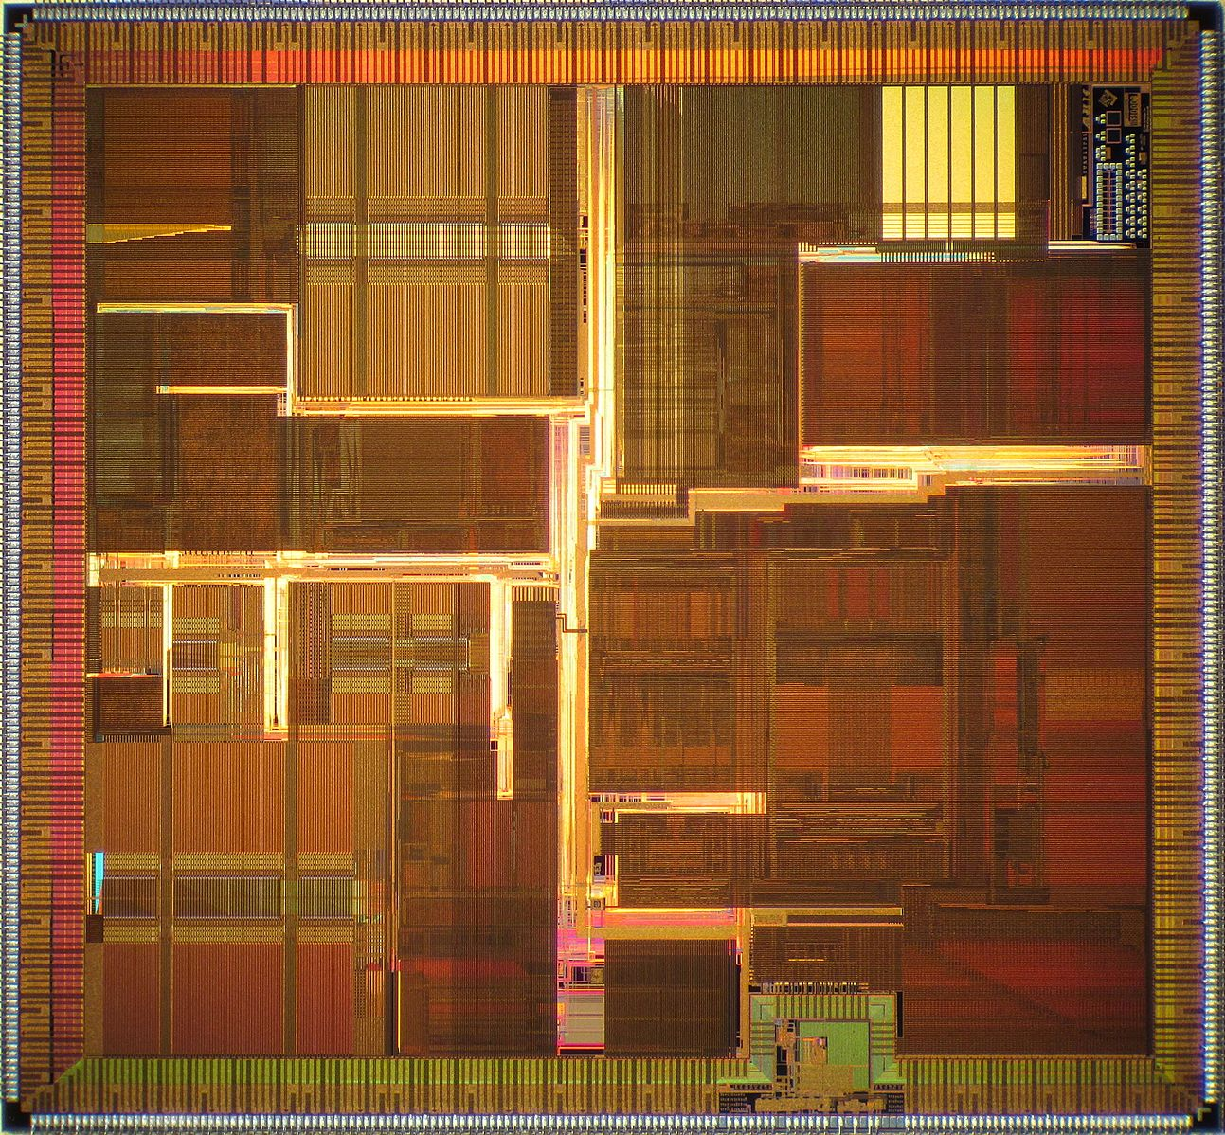
Design Overview
Out-of-Order pipeline processor
Based on R10K
3-way scalar
NEC VR10K Die Shot

Slide 3
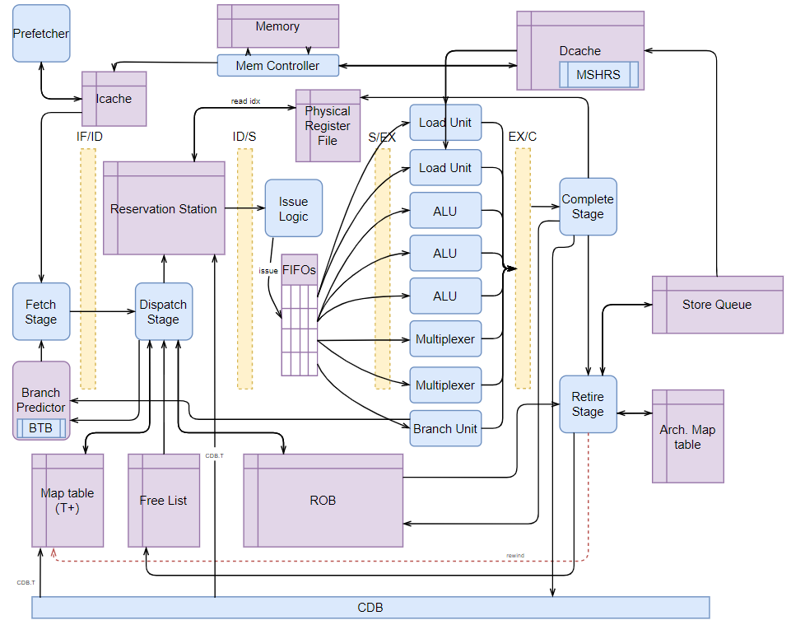
Basic Features
Fetch Stage
Three Instructions at a time
Stalls on cache miss or dispatch stall
Dispatch Stage
3 decoders embedded
Reservation Station
16 entries
Use Priority Selectors to choose instructions to issue
FIFO queues for different kinds of FUs

Slide 4
Basic Features
Reorder Buffer
32 entries
Head and tail pointers - non-retire instructions
Precise state: reset all entries and pointers
Functional Units
ALUs handle stores

Slide 5
Basic Features
Freelist
32 entries
Head and tail pointers - free reg in between
Precise state: set head pointer right after tail pointer
Map Tables
32 Arch regs
64 Physical regs

Slide 6
Advanced Features
Prefetcher
Triggered on every reference
Prefetches 12 lines* of data from memory and write into ICache
Tells fetch if some data has been requested from memory

Slide 7
Advanced Features
Branch Predictor
32 entries
Directly mapped
Based on a 2-bit saturating counter
Initialized as not-taken
Store Queue
8 entries
Every load instruction waits until all the store instructions in the queue are executed

Slide 8
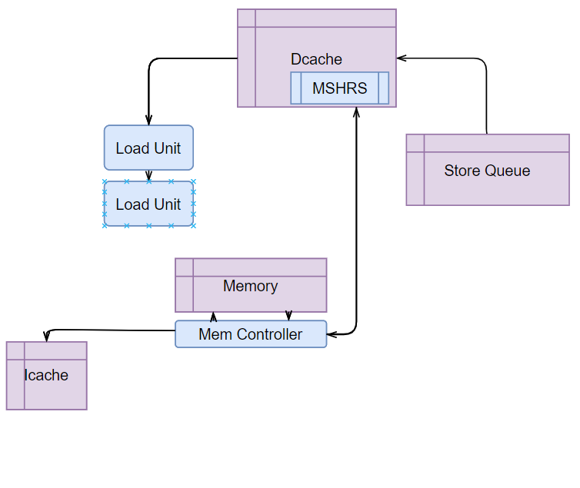
Memory Interface
Non-blocking Instruction Cache
32 lines, directed mapped
Non-blocking Data Cache
32 lines, directed mapped
Write-back
Write-allocate
Uses a Dcache controller with a 16-entry Miss Status Handling Registers (MHSRs) to sequentialize memory accesses.
Memory Controller
Give Dcache higher priority

Slide 9
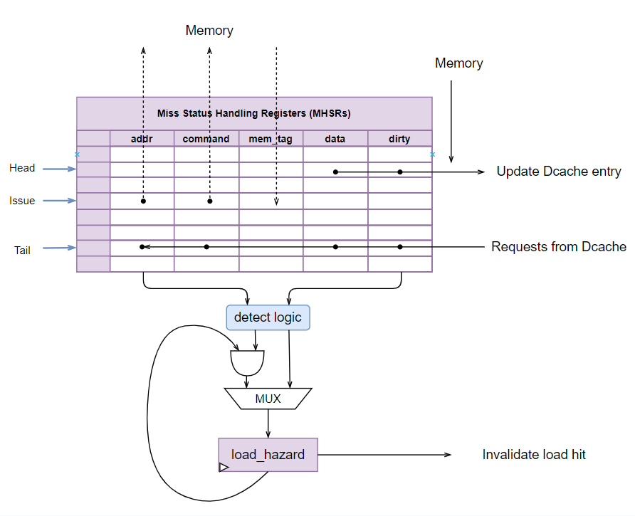
Memory Interface
Miss Status Handling Registers
16 entries, FIFO
Designed to track memory tags, and record information of multiple accesses.
Dcache Controller
Special cache updating logic
A “load hazard” detector to avoid loading wrong data.

Slide 10
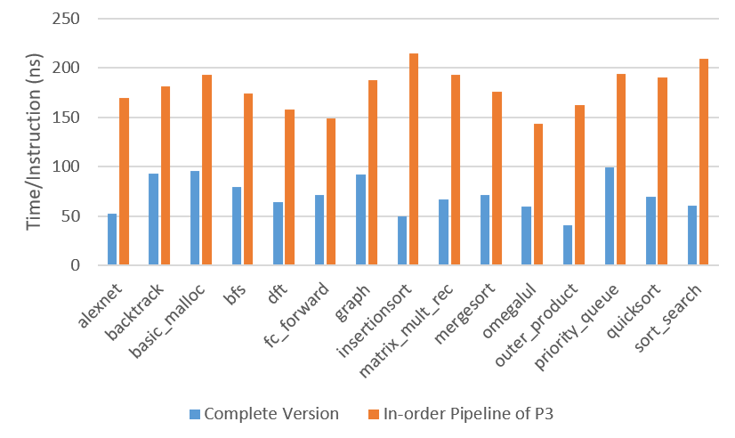
Performance Analysis
Overall Performance:
Versus in-order pipeline
Time/Instruction reduced significantly
Time/Instruction = CPI × Period

Slide 11
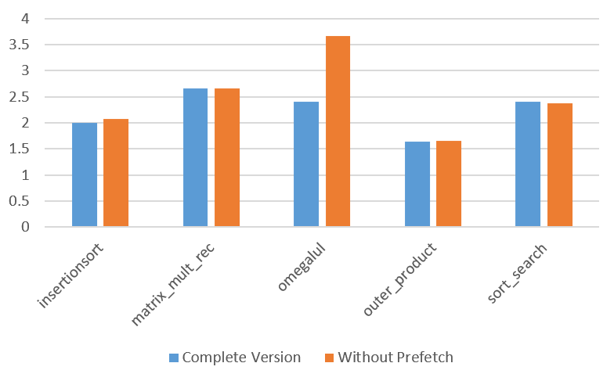
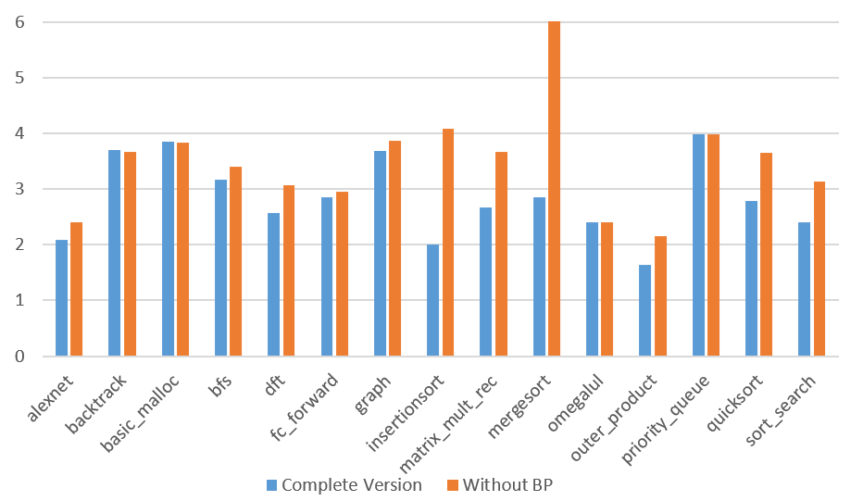
Performance Analysis
Prefetch:
Overall efficient
Poor in branch-taken
Branch Predictor:
Overall efficient
Poor in changeable pattern

Slide 12
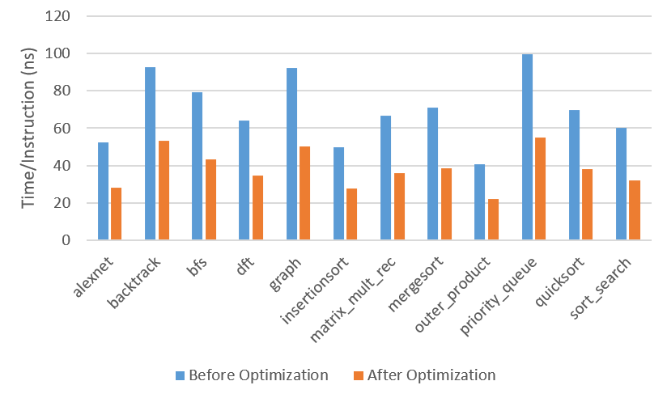
Performance Analysis
Up-to-date Version:
Period greatly reduced
CPI slightly increased
Half time/instruction

Slide 13
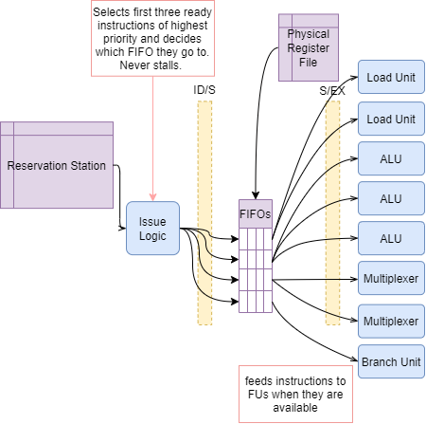
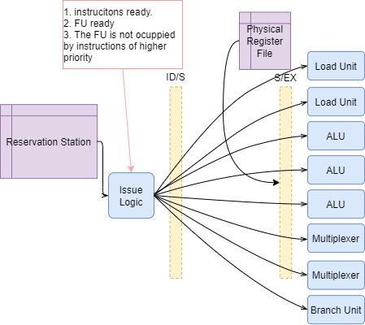
Optimization
Issue selection logic Separation
Critical path: 15ns => 9ns

Slide 14
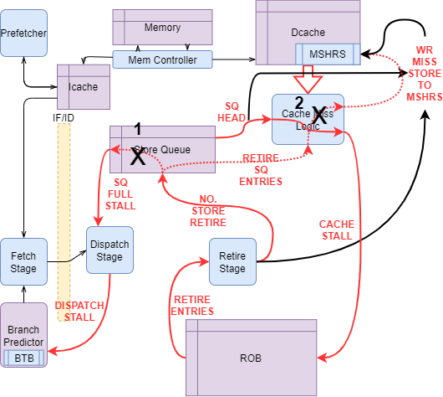
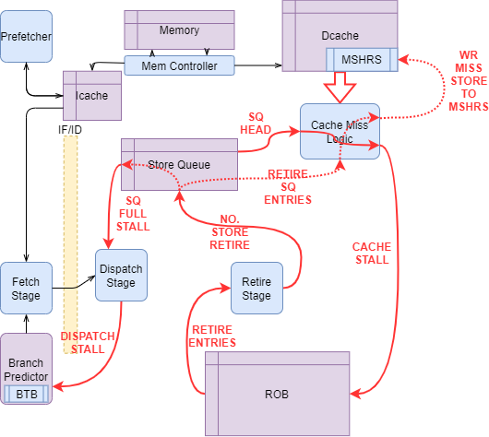
Optimization
DCache Stall Logic Critical Path Elimination
Target: Allow only one missed store at a time
Cancel SQ internal forwarding
Eliminate redundant cache miss logic

Slide 15
Optimization
DCache Stall Logic Critical Path Elimination
Target: Allow only one missed store at a time
Cancel SQ internal forwarding
Eliminate redundant cache miss logic
Cycle period: 25ns => 13.1ns

Slide 16
1.85x
Time/inst: 71.07ns => 38.35ns
Speedup After Optimization

Slide 17
Questions?

